Slide 1
Multiview Depth Image Enhancement for Free-viewpoint Television
Pravin Kumar Rana, Zhanyu Ma, Jalil Taghia, and Markus Flierl
Opponents: Nasser Mohammadiha, Haopeng Li and, Jalil Taghia
Internal seminar, Communication Theory, KTH
June 27, 2013

Slide 2
Motivation & Background

Slide 3
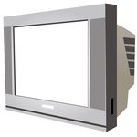

Conventional Television
User | Display
1

Slide 4
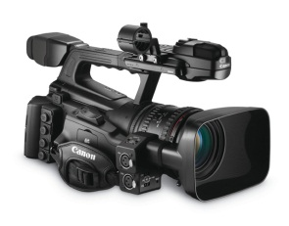
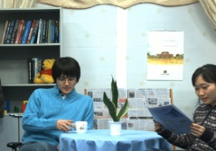
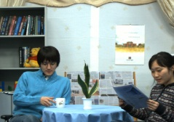
Conventional Television
User | Display
1

Slide 5
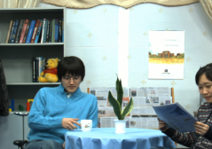
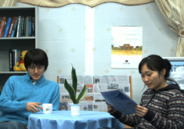
Free-viewpoint Television
User | Display
Multiview imagery
2

Slide 6
Free-viewpoint Television
User | Display
Multiview imagery
2

Slide 7
Free-viewpoint Television
User | Display
Multiview imagery
2

Slide 8
Free-viewpoint Television
User | Display
Multiview imagery
2

Slide 9
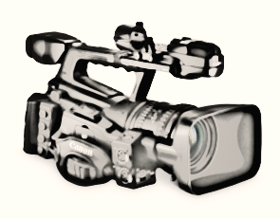
Free-viewpoint Television
User | Display
Virtual camera | Virtual view
Multiview imagery
2

Slide 10
Virtual View Synthesis
Depth Image Based Rendering
Virtual camera | Virtual view
Multiview imagery
3

Slide 11
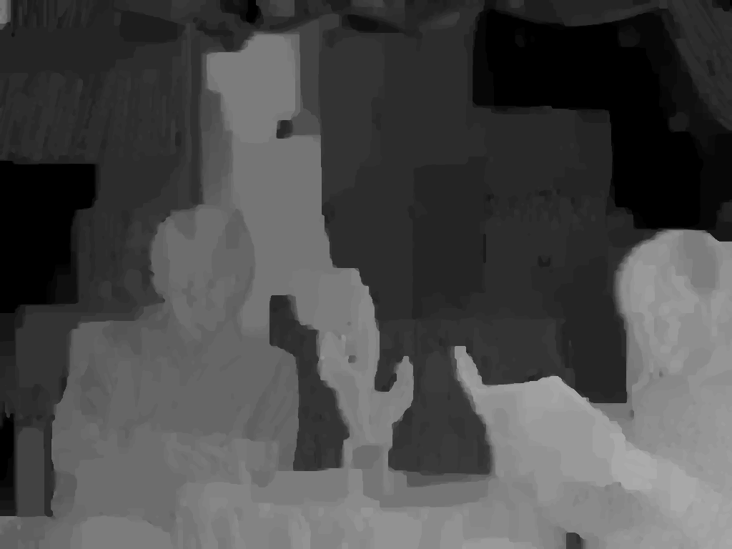
Depth Image Based Rendering
Depth image
Near
Far
Virtual camera | Virtual view
Multiview imagery
4

Slide 12
Depth Image Based Rendering
Depth pixels represent shortest distance between object points and the camera plane
To be estimated from multiview imagery
Depth image
Near
Far
Virtual camera | Virtual view
Multiview imagery
4

Slide 13
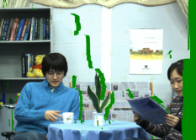

Depth Image Based Rendering
Depth pixels represent shortest distance between object points and the camera plane
To be estimated from multiview imagery
Depth image
Near
Far
Virtual camera | Virtual view
3D warping
Multiview imagery
4

Slide 14
Depth Image Based Rendering
3D Warping
Physical camera
parameters
Virtual camera
parameters
4

Slide 15
Depth Image Based Rendering
3D Warping
Physical camera
parameters
Virtual camera
parameters
4

Slide 16
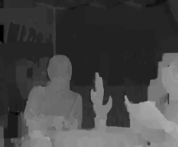
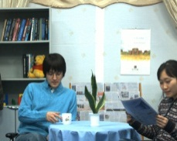
Depth Image Based Rendering
3D Warping
Physical camera
parameters
Virtual camera
parameters
4

Slide 17
Depth Image Based Rendering
3D Warping
Physical camera
parameters
Virtual camera
parameters
4

Slide 18
Depth Image Based Rendering
Depth pixels represent shortest distance between object points and the camera plane
To be estimated from multiview imagery
Depth image
Near
Far
Virtual camera | Virtual view
3D warping
[1] C. Fehn: Depth-image-based rendering DIBR, compression, and transmission for a new approach on 3D-TV, SPIE, 2004.
Multiview imagery
4

Slide 19



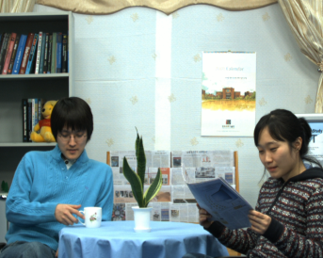
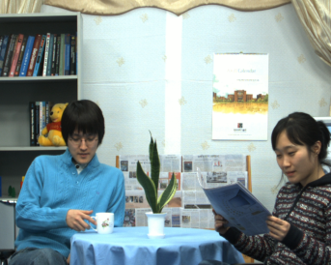

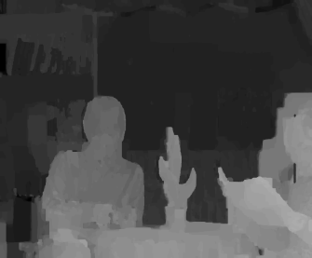
Depth Image Estimation
MPEG Depth Estimation Reference Software (DERS)
View (n-2) | View (n-1) | View (n) | View (n+1) | View (n+2) | View (n+3)
DERS
Estimated depth maps
View (n-2) | View (n-1) | View (n) | View (n+1)
5

Slide 20
Depth Image Estimation
MPEG Depth Estimation Reference Software (DERS)
View (n-2) | View (n-1) | View (n) | View (n+1) | View (n+2) | View (n+3)
DERS
Stereo-matching algorithm with Graph-cut optimization
Estimated depth maps
View (n-2) | View (n-1) | View (n) | View (n+1)
5

Slide 21
Depth Image Estimation
MPEG Depth Estimation Reference Software (DERS)
View (n-2) | View (n-1) | View (n) | View (n+1) | View (n+2) | View (n+3)
DERS
View (n-2) | View (n-1) | View (n) | View (n+1)
5

Slide 22
Depth Image Estimation
MPEG Depth Estimation Reference Software (DERS)
View (n-2) | View (n-1) | View (n) | View (n+1) | View (n+2) | View (n+3)
DERS
DERS
View (n-2) | View (n-1) | View (n) | View (n+1) | View (n+2) | View (n+3)
5

Slide 23
Depth Image Estimation
MPEG Depth Estimation Reference Software (DERS)
View (n-2) | View (n-1) | View (n) | View (n+1) | View (n+2) | View (n+3)
DERS
DERS
Estimated depth maps
View (n-2) | View (n-1) | View (n) | View (n+1) | View (n+2) | View (n+3)
5

Slide 24
Depth Image Estimation
MPEG Depth Estimation Reference Software (DERS)
View (n-2) | View (n-1) | View (n) | View (n+1) | View (n+2) | View (n+3)
DERS
DERS
Estimated depth maps
View (n-2) | View (n-1) | View (n) | View (n+1) | View (n+2) | View (n+3)
Note: we assume a 1D-parallel camera arrangement
Note: we assume a 1D-parallel camera arrangement
5

Slide 25
Depth Image Estimation
MPEG Depth Estimation Reference Software (DERS)
View (n-2) | View (n-1) | View (n) | View (n+1) | View (n+2) | View (n+3)
DERS
DERS
Estimated depth maps
View (n-2) | View (n-1) | View (n) | View (n+1) | View (n+2) | View (n+3)
Note: we assume a 1D-parallel camera arrangement
Note: we assume a 1D-parallel camera arrangement
5

Slide 26
Depth Image Estimation
MPEG Depth Estimation Reference Software (DERS)
View (n-2) | View (n-1) | View (n) | View (n+1) | View (n+2) | View (n+3)
DERS
DERS
Estimated depth maps
View (n-2) | View (n-1) | View (n) | View (n+1) | View (n+2) | View (n+3)
Note: we assume a 1D-parallel camera arrangement
Note: we assume a 1D-parallel camera arrangement
5

Slide 27
Depth Image Estimation
MPEG Depth Estimation Reference Software (DERS)
View (n-2) | View (n-1) | View (n) | View (n+1) | View (n+2) | View (n+3)
DERS
DERS
Estimated depth maps
View (n-2) | View (n-1) | View (n) | View (n+1) | View (n+2) | View (n+3)
Problem: Inter-view depth inconsistency
Note: we assume a 1D-parallel camera arrangement
Note: we assume a 1D-parallel camera arrangement
5

Slide 28
Depth Image Estimation
MPEG Depth Estimation Reference Software (DERS)
View (n-2) | View (n-1) | View (n) | View (n+1) | View (n+2) | View (n+3)
DERS
DERS
Estimated depth maps
View (n-2) | View (n-1) | View (n) | View (n+1) | View (n+2) | View (n+3)
Problem: Inter-view depth inconsistency
Note: we assume a 1D-parallel camera arrangement
5

Slide 29
Depth Enhancement Framework

Slide 30
Overview of Depth Enhancement Framework
Multiview view and depth images
Color Classification
Depth Classification
Enhanced multiview depth images
6

Slide 31
Overview of Depth Enhancement Framework
Multiview view and depth images
Concatenation of view imagery
Multiview color classification
Depth Classification
Enhanced multiview depth images
6

Slide 32
Overview of Depth Enhancement Framework
Multiview view and depth images
Concatenation of view imagery
Multiview color classification
Multiview depth classification
Multiview depth subclassification
Enhanced multiview depth images
6

Slide 33
Concatenation of View Imagery
View (n-1) | View (n) | View (n+1) | View (n+2)
7
Notes:
-Multiview imagery has inherent inter-view similarity
-To have a unique model for multiview imagery,
-The inherent inter-view similarity is exploited by concatenating views from multiple viewpoints

Slide 34
Concatenation of View Imagery
View (n-1) | View (n) | View (n+1) | View (n+2)
View (n-1) | View (n) | View (n+1) | View (n+2)
7
Notes:
-Multiview imagery has inherent inter-view similarity
-To have a unique model for multiview imagery,
-The inherent inter-view similarity is exploited by concatenating views from multiple viewpoints

Slide 35
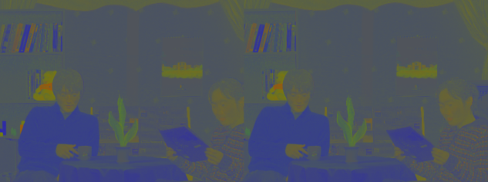
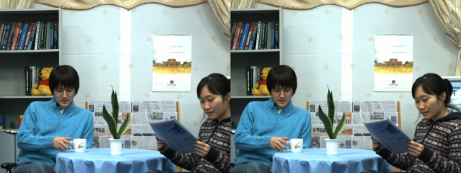
Multiview Color Classification
View (n) | View (n+1)
…
…
RGB Color space
8

Slide 36
Multiview Color Classification
View (n) | View (n+1)
…
…
xyz Chromatic color space
8

Slide 37
Multiview Color Classification
View (n) | View (n+1)
…
…
xyz Chromatic color space
Insensitive to the absolut luminance
A pixel is described by a vector of three chromaticity coefﬁcients [x y z]^{T}, where
x+y+z = 1
8

Slide 38
Multiview Color Classification
Why variational Bayes inference (VI)?
The goal of classification is to partition an image into regions each of which has a reasonably homogeneous visual appearance
Usually, clustering algorithm suffers from one major drawbacks that the number of clusters has to be known
Bayesian approaches automatically and optimally select the number of clusters
Use of variational inference (VI) framework for Bayesian approaches gives an analytically tractable solution
[2] C. M. Bishop, Pattern Recognition and Machine Learning, 1st ed. New York: Springer, 2006.
9

Slide 39
Multiview Color Classification
Why Dirichlet mixture models (DMM) ?
The pixel vector in the chromaticity space has
nonnegative elements
bounded by the interval [0,1]
sum to one
Assume that these pixel vectors are Dirichlet distributed
DMM with variational inference is used to capture all underlying color clusters in multiview imagery
It reduces complexity
[3] P. K. Rana, J. Taghia, and M. Flierl: A Variational Bayesian Inference Framework for Multiview Depth Image Enhancement, IEEE ISM, 2012.
[4] Z. Ma, P. K. Rana, J. Taghia, M. Flierl, and A. Leijon: Bayesian estimation of Dirichlet mixture model with variational inference, submitted, 2013.
9

Slide 40

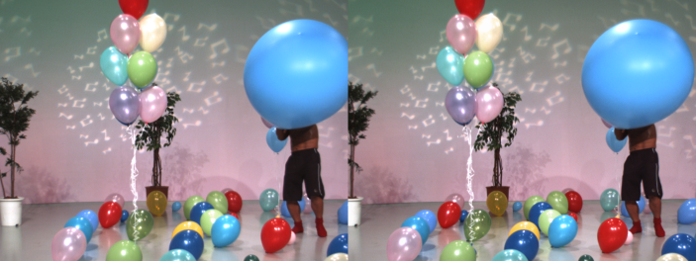
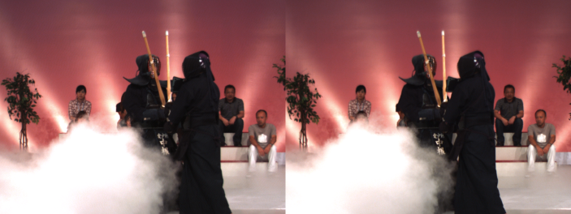
Multiview Color Classification
Newspaper Balloons Kendo
Input multiview data
10

Slide 41
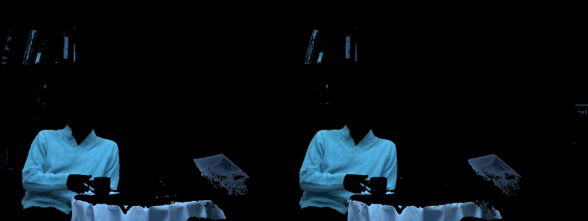
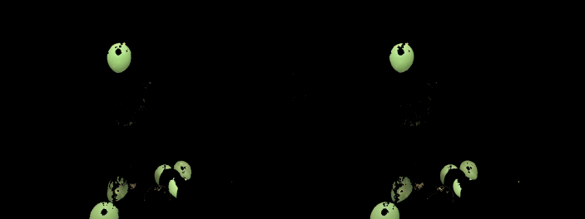
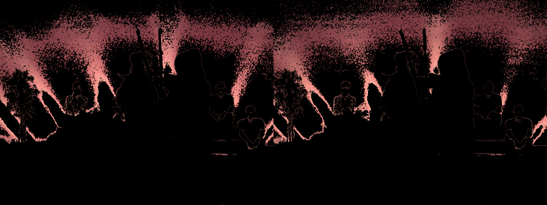
Multiview Color Classification
Newspaper Balloons Kendo
Input multiview data
Using VI-DMM
10

Slide 42

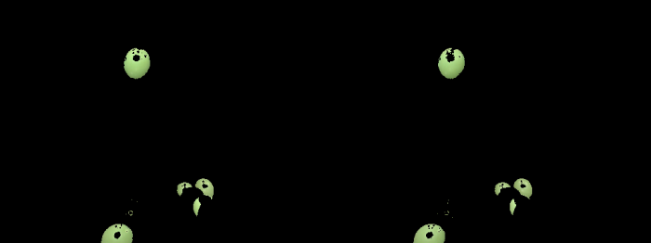
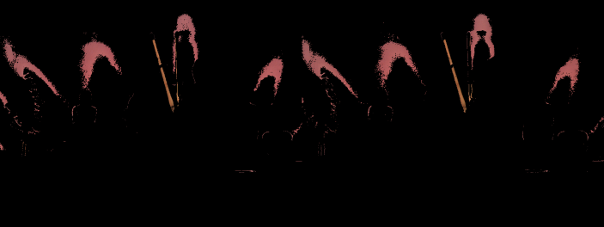
Multiview Color Classification
Newspaper Balloons Kendo
Input multiview data
Using VI-DMM
Using VI-GMM
10

Slide 43
Multiview Color Classification
Newspaper Balloons Kendo
Input multiview data
Using VI-DMM
Using VI-GMM
10

Slide 44
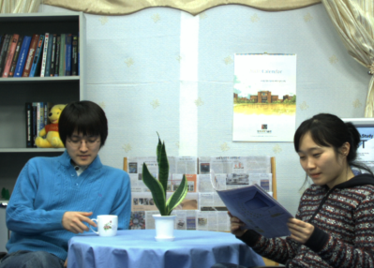
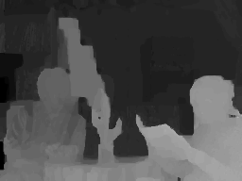
Multiview Depth Classification
Exploiting the per-pixel association between color and depth
View image | Depth image
11

Slide 45
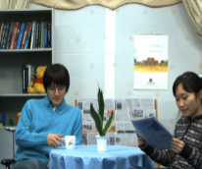
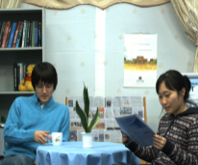
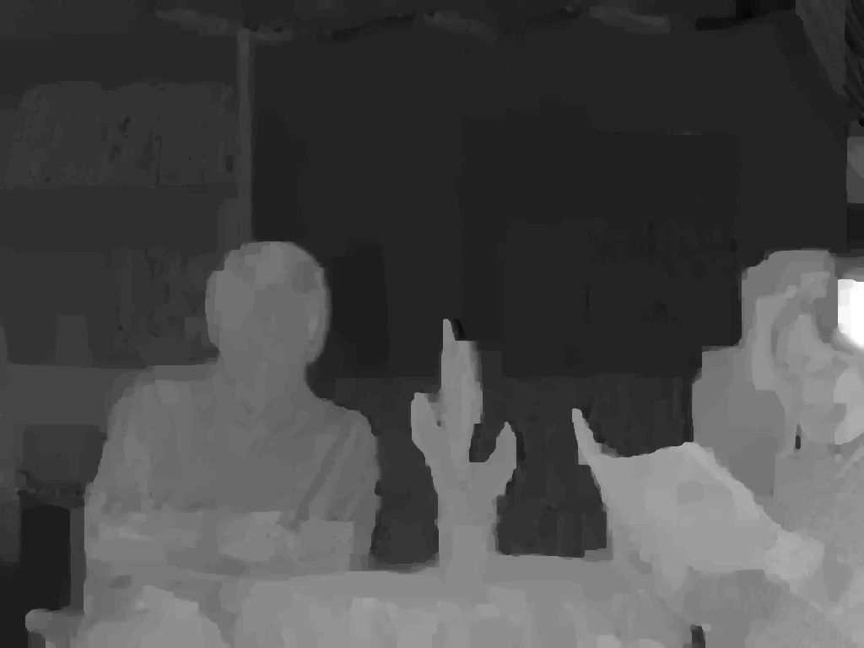

Multiview Depth Classification
Exploiting the per-pixel association between color and depth
View image | Depth image
Concatenated view imagery | Concatenated depth imagery
11

Slide 46
Multiview Depth Classification
Newspaper Balloons Kendo
Input multiview data
Using VI-DMM
12

Slide 47
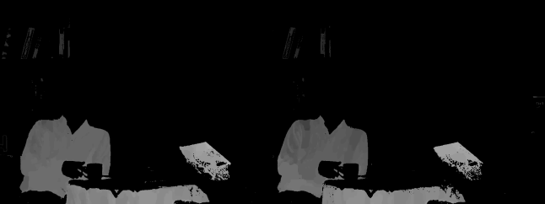
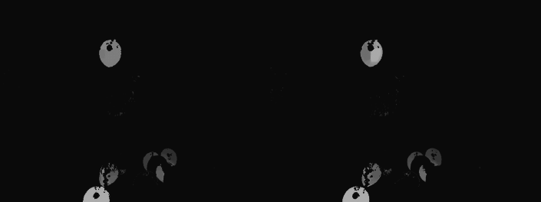
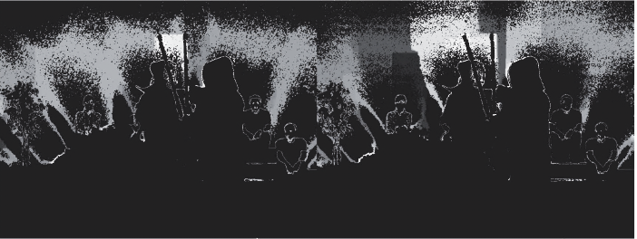
Multiview Depth Classification
Newspaper Balloons Kendo
Input multiview data
Using VI-DMM
Depth clusters
12

Slide 48
Multiview Depth Classification
Newspaper Balloons Kendo
Input multiview data
Using VI-DMM
Depth clusters
12

Slide 49
Multiview Depth Subclassification
Difference between color and depth clusters
Members of color cluster have similar colors pixels
Members of depth cluster may have different depth values
Why?
due to foreground and background depth difference
due to inter-view inconsistency
13
Notes:
The members of a cluster are similar colors, whereas members of the corresponding depth cluster are different depth values.
Inter-view depth inconsistency : If an object point with a given color is visible from N viewpoints, this point should have the same depth value in all N depth maps.
However, such points usually have different depth values in the depth cluster due to the inconsistency across multiple viewpoints.

Slide 50
Multiview Depth Subclassification
Mean shift Clustering
A nonparametric clustering technique
Knowledge of the number of clusters not required
Assigns the mean to depth pixels irrespective of the originating viewpoints
Generative model based approaches imply higher computational complexity
[5] D. Comaniciu and P. Meer: Mean shift: A robust approach toward feature space analysis, IEEE Trans. Pattern Anal. Mach. Intell., 2002.
14
Notes:
The members of a cluster are similar colors, whereas members of the corresponding depth cluster are different depth values.
Inter-view depth inconsistency : If an object point with a given color is visible from N viewpoints, this point should have the same depth value in all N depth maps.
However, such points usually have different depth values in the depth cluster due to the inconsistency across multiple viewpoints.

Slide 51
Experimental Results

Slide 52

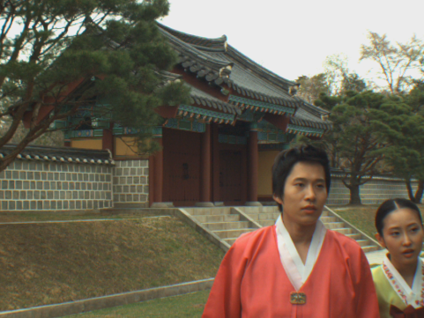
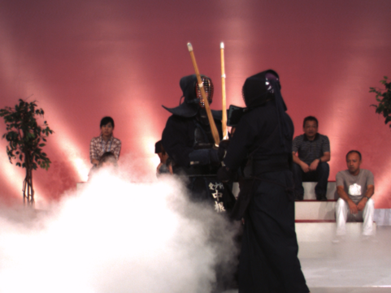
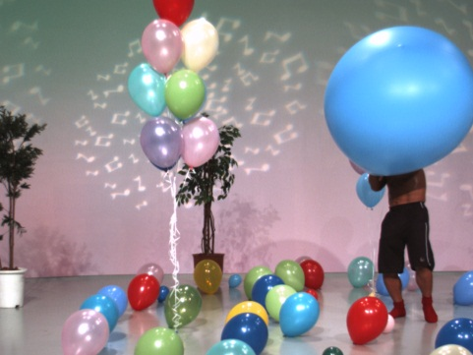
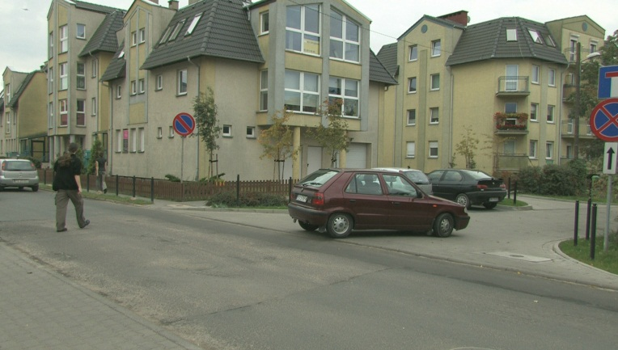
Experimental Results
MPEG 3DTV multiview data set
Newspaper
(1024 X 768)
Lovebird1
(1024 X 768)
Kendo
(1024 X 768)
Balloons
(1024 X 768)
Poznan street
(1920 X 1088)
15

Slide 53
Experimental Results
Multiview data set | Initial number of mixture components | Active number of mixture components (after convergence)
 |  | VI-GMM | VI-DMM
Lovebird1 | 100 | 31 | 24
Kendo | 100 | 34 | 15
16

Slide 54
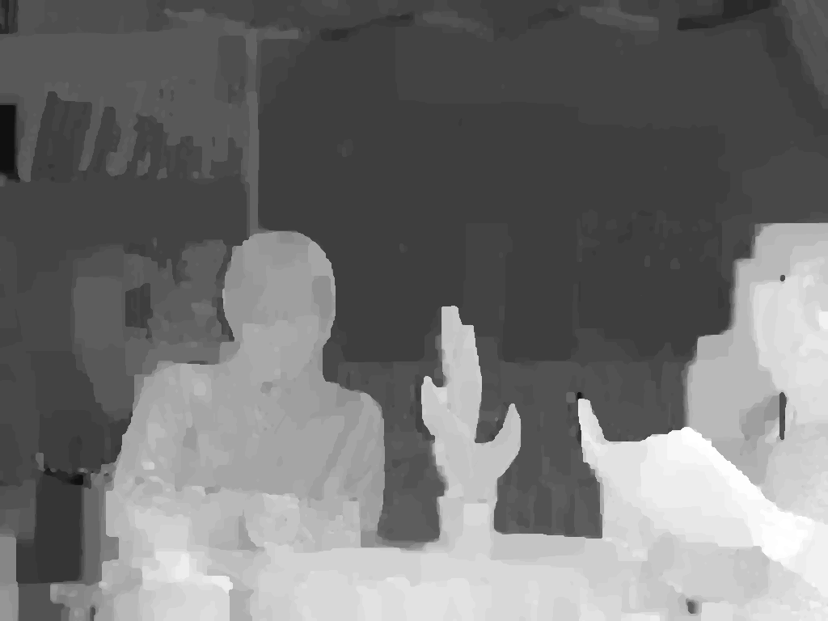
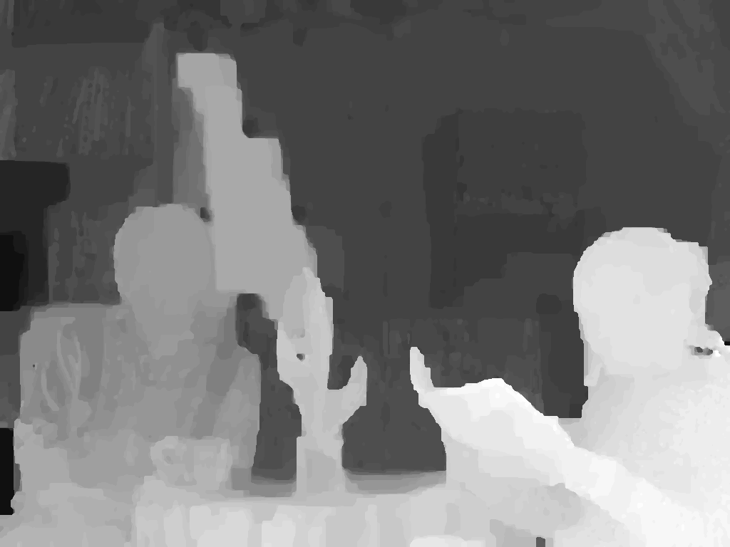
Depth Image-Based Rendering
MPEG View Synthesis Reference Software (VSRS) 3.5
Enhanced depth map
Left
Enhanced depth map
Right
17

Slide 55
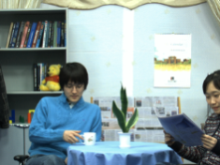

Depth Image-Based Rendering
MPEG View Synthesis Reference Software (VSRS) 3.5
Enhanced depth map
Left
Reference view
Enhanced depth map
Right
Reference view
17

Slide 56

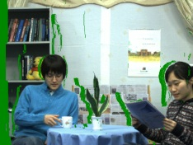
Depth Image-Based Rendering
MPEG View Synthesis Reference Software (VSRS) 3.5
Enhanced depth map
Warped view
3D warping
Left
Reference view
Enhanced depth map
3D warping
Right
Warped view
Reference view
17

Slide 57
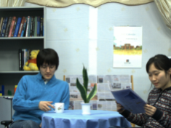
Depth Image-Based Rendering
MPEG View Synthesis Reference Software (VSRS) 3.5
Enhanced depth map
Warped view
3D warping
Left
Reference view
Hole filling & inpainting
Enhanced depth map
Virtual intermediate
view
3D warping
Right
Warped view
Reference view
17

Slide 58

Depth Image-Based Rendering
MPEG View Synthesis Reference Software (VSRS) 3.5
Enhanced depth map
Warped view
3D warping
Left
Reference view
Hole filling & inpainting
Enhanced depth map
Virtual intermediate
view
3D warping
Right
Warped view
Reference view
Original camera view
17

Slide 59
Depth Image-Based Rendering
MPEG View Synthesis Reference Software (VSRS) 3.5
Enhanced depth map
Warped view
3D warping
Left
Y-PSNR (dB)
Reference view
Hole filling & inpainting
Enhanced depth map
Virtual intermediate
view
3D warping
Right
Warped view
Reference view
Original camera view
17

Slide 60
Objective Results
Test sequence | Input view pair | Virtual view | Y-PSNR [dB]
 |  |  | With MPEG depth maps | With VBIGMM + K-Means depth maps [3] | With VBIDMM + Mean-shift depth maps
Newspaper | (4, 6) | 5 | 32.00 | 32.10 | 32.11
Kendo | (3, 5) | 4 | 36.54 | 36.72 | 39.35
Lovebird1 | (6, 8) | 7 | 28.50 | 28.68 | 29.04
Balloons | (3, 5) | 4 | 35.69 | 35.93 | 36.02
Poznan Street | (3, 5) | 4 | 35.56 | 35.58 | 35.72
K-means sub-clustering
Number of cluster : 12
[3] P. K. Rana, J. Taghia, and M. Flierl: A Variational Bayesian Inference Framework for Multiview Depth Image Enhancement, IEEE ISM, 2012.
18

Slide 61
Objective Results
Test sequence | Input view pair | Virtual view | Y-PSNR [dB]
 |  |  | With MPEG depth maps | With VBIGMM + K-Means depth maps [3] | With VBIDMM + Mean-shift depth maps
Newspaper | (4, 6) | 5 | 32.00 | 32.10 | 32.11
Kendo | (3, 5) | 4 | 36.54 | 36.72 | 39.35
Lovebird1 | (6, 8) | 7 | 28.50 | 28.68 | 29.04
Balloons | (3, 5) | 4 | 35.69 | 35.93 | 36.02
Poznan Street | (3, 5) | 4 | 35.56 | 35.58 | 35.72
K-means sub-clustering
Number of cluster : 12
[3] P. K. Rana, J. Taghia, and M. Flierl: A Variational Bayesian Inference Framework for Multiview Depth Image Enhancement, IEEE ISM, 2012.
18

Slide 62
Objective Results
Test sequence | Input view pair | Virtual view | Y-PSNR [dB]
 |  |  | With MPEG depth maps | With VBIGMM + K-Means depth maps [3] | With VBIDMM + Mean-shift depth maps
Newspaper | (4, 6) | 5 | 32.00 | 32.10 | 32.11
Kendo | (3, 5) | 4 | 36.54 | 36.72 | 39.35
Lovebird1 | (6, 8) | 7 | 28.50 | 28.68 | 29.04
Balloons | (3, 5) | 4 | 35.69 | 35.93 | 36.02
Poznan Street | (3, 5) | 4 | 35.56 | 35.58 | 35.72
K-means sub-clustering
Number of cluster : 12
[3] P. K. Rana, J. Taghia, and M. Flierl: A Variational Bayesian Inference Framework for Multiview Depth Image Enhancement, IEEE ISM, 2012.
18

Slide 63
Objective Results
Test sequence | Input view pair | Virtual view | Y-PSNR [dB]
 |  |  | With MPEG depth maps | With VBIGMM + K-Means depth maps [3] | With VBIDMM + Mean-shift depth maps
Newspaper | (4, 6) | 5 | 32.00 | 32.10 | 32.11
Kendo | (3, 5) | 4 | 36.54 | 36.72 | 39.35
Lovebird1 | (6, 8) | 7 | 28.50 | 28.68 | 29.04
Balloons | (3, 5) | 4 | 35.69 | 35.93 | 36.02
Poznan Street | (3, 5) | 4 | 35.56 | 35.58 | 35.72
K-means sub-clustering
Number of cluster : 12
[3] P. K. Rana, J. Taghia, and M. Flierl: A Variational Bayesian Inference Framework for Multiview Depth Image Enhancement, IEEE ISM, 2012.
18

Slide 64
Objective Results
Test sequence | Input view pair | Virtual view | Y-PSNR [dB]
 |  |  | With MPEG depth maps | With VBIGMM + K-Means depth maps [3] | With VBIDMM + Mean-shift depth maps
Newspaper | (4, 6) | 5 | 32.00 | 32.10 | 32.11
Kendo | (3, 5) | 4 | 36.54 | 36.72 | 39.35
Lovebird1 | (6, 8) | 7 | 28.50 | 28.68 | 29.04
Balloons | (3, 5) | 4 | 35.69 | 35.93 | 36.02
Poznan Street | (3, 5) | 4 | 35.56 | 35.58 | 35.72
K-means sub-clustering
Number of cluster : 12
[3] P. K. Rana, J. Taghia, and M. Flierl: A Variational Bayesian Inference Framework for Multiview Depth Image Enhancement, IEEE ISM, 2012.
18

Slide 65
Objective Results
Test sequence | Input view pair | Virtual view | Y-PSNR [dB]
 |  |  | With MPEG depth maps | With VBIGMM + K-Means depth maps [3] | With VBIDMM + Mean-shift depth maps
Newspaper | (4, 6) | 5 | 32.00 | 32.10 | 32.11
Kendo | (3, 5) | 4 | 36.54 | 36.72 | 39.35
Lovebird1 | (6, 8) | 7 | 28.50 | 28.68 | 29.04
Balloons | (3, 5) | 4 | 35.69 | 35.93 | 36.02
Poznan Street | (3, 5) | 4 | 35.56 | 35.58 | 35.72
K-means sub-clustering
Number of cluster : 12
[3] P. K. Rana, J. Taghia, and M. Flierl: A Variational Bayesian Inference Framework for Multiview Depth Image Enhancement, IEEE ISM, 2012.
18

Slide 66
Objective Results
Test sequence | Input view pair | Virtual view | Y-PSNR [dB]
 |  |  | With MPEG depth maps | With VBIGMM + K-Means depth maps [3] | With VBIDMM + Mean-shift depth maps
Newspaper | (4, 6) | 5 | 32.00 | 32.10 | 32.11
Kendo | (3, 5) | 4 | 36.54 | 36.72 | 39.35
Lovebird1 | (6, 8) | 7 | 28.50 | 28.68 | 29.04
Balloons | (3, 5) | 4 | 35.69 | 35.93 | 36.02
Poznan Street | (3, 5) | 4 | 35.56 | 35.58 | 35.72
K-means sub-clustering
Number of cluster : 12
[3] P. K. Rana, J. Taghia, and M. Flierl: A Variational Bayesian Inference Framework for Multiview Depth Image Enhancement, IEEE ISM, 2012.
18

Slide 67
Objective Results
Test sequence | Input view pair | Virtual view | Y-PSNR [dB]
 |  |  | With MPEG depth maps | With VI-GMM + K-Means depth maps [3] | With VI-DMM + Mean-shift depth maps
Newspaper | (4, 6) | 5 | 32.00 | 32.10 | 32.11
Kendo | (3, 5) | 4 | 36.54 | 36.72 | 39.35
Lovebird1 | (6, 8) | 7 | 28.50 | 28.68 | 29.04
Balloons | (3, 5) | 4 | 35.69 | 35.93 | 36.02
Poznan Street | (3, 5) | 4 | 35.56 | 35.58 | 35.72
K-means sub-clustering
Number of cluster : 12
[3] P. K. Rana, J. Taghia, and M. Flierl: A Variational Bayesian Inference Framework for Multiview Depth Image Enhancement, IEEE ISM, 2012.
18

Slide 68
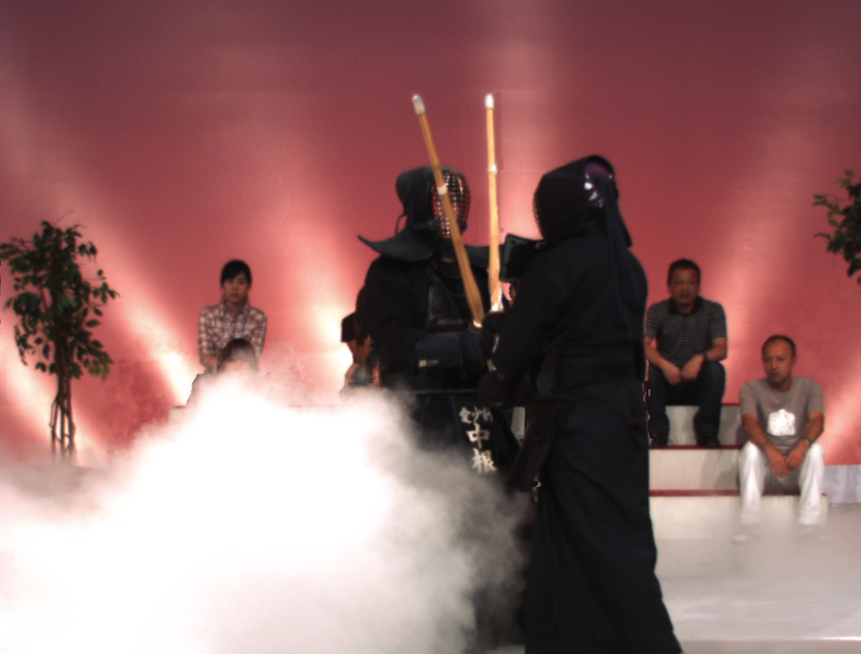
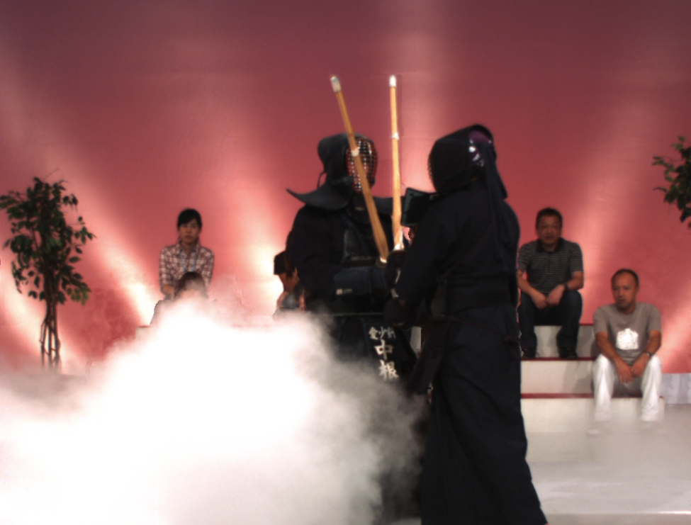
Subjective Results
Test sequence: Kendo
With MPEG depth map
With VI-DMM+Mean-shift depth map
19

Slide 69
Subjective Results
Test sequence: Kendo
With MPEG depth map
With VI-DMM+Mean-shift depth map
19

Slide 70

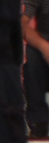

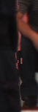
Subjective Results
Test sequence: Kendo
Original
With VI-DMM + Mean-Shift
depth maps
With VI-GMM + K-Means
depth maps
With MPEG depth maps
19

Slide 71
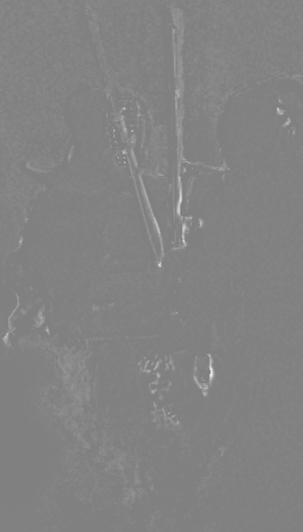
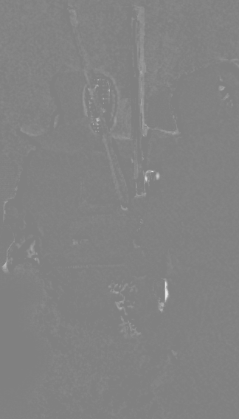
Subjective Results
Test sequence: Kendo
With VI-GMM
+K-Means
depth maps
With VI-DMM +Mean-Shift
depth maps
20

Slide 72
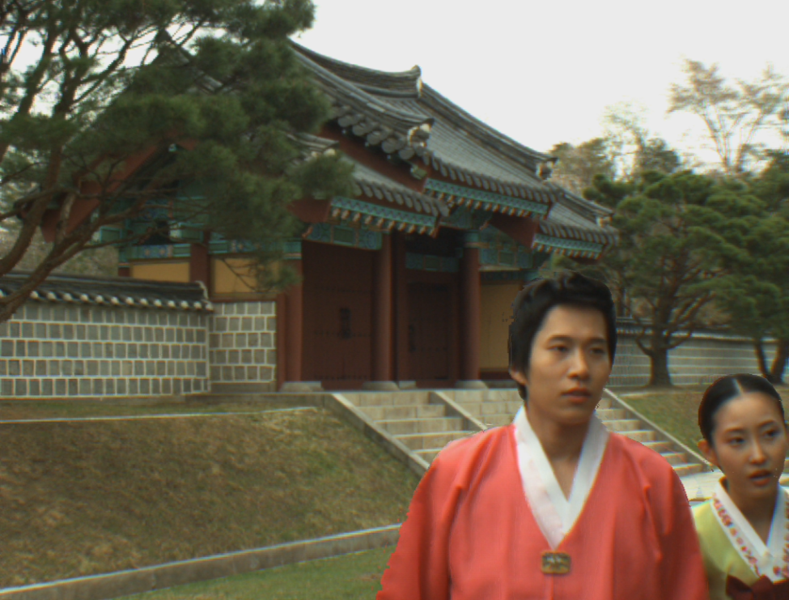
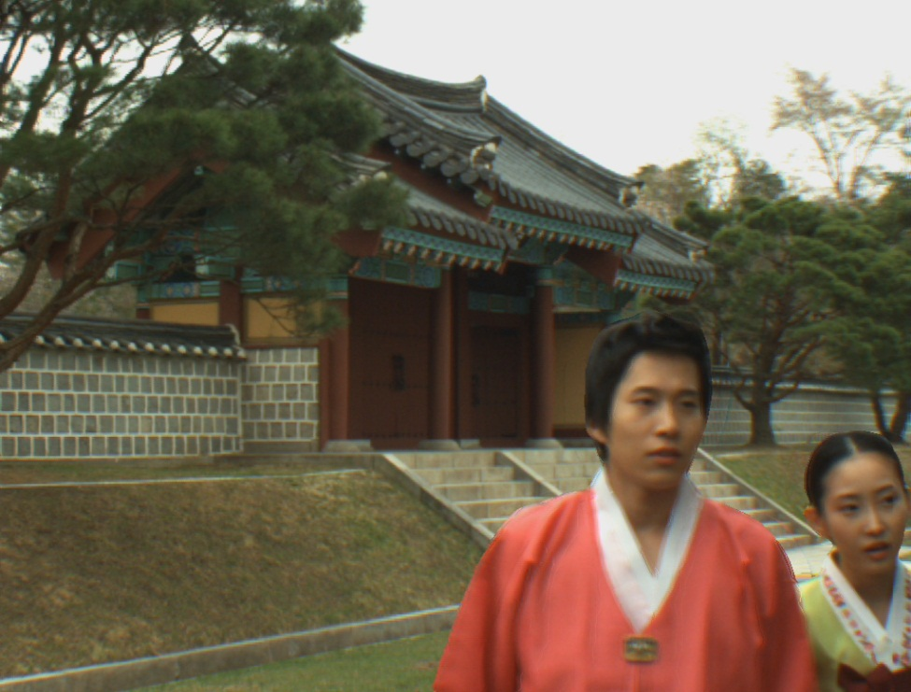
Subjective Results
Test sequence: Lovebird 1
With MPEG depth map
With VI-DMM+Mean-shift depth map
21

Slide 73
Subjective Results
Test sequence: Lovebird 1
With MPEG depth map
With VI-DMM+Mean-shift depth map
21

Slide 74
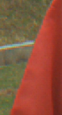
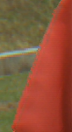


Subjective Results
Test sequence: Lovebird 1
Original
With VI-DMM +Mean-Shift
depth maps
With VI-GMM +K-Means
depth maps
With MPEG depth maps
21

Slide 75
Subjective Results
Test sequence: Lovebird 1
With MPEG depth map
With VI-DMM+Mean-shift depth map
21

Slide 76




Subjective Results
Test sequence: Lovebird 1
Original
With VI-DMM +Mean-Shift
depth maps
With VI-GMM +K-Means
depth maps
With MPEG depth maps
21

Slide 77
Conclusions
The inter-view depth consistency and hence, the free-viewpoint experience improve
The per-pixel association between depth and color is exploited by classification
Depth subclassification improves depth maps and hence, view rendering quality
Both objective and subjective results improve
[6] P. K. Rana, Z. Ma, J. Taghia, and M. Flierl: Multiview Depth Map Enhancement by Variational Bayes Inference Estimation of Dirichlet Mixture Models, IEEE ICASSP, 2013.
22

Slide 78
Future Directions
A fully probabilistic multiview depth image enhancement
With improved computational efficiency
With improved depth subclassification
23

Slide 79
Thank You

Slide 80
Multiview color classification
Multiview color classification
Dirichlet mixture model with variational Bayes inference
Repeat
Until convergence
xyz
data
Initialization
Optimization of the variational posterior distribution
Variational lower bound evaluation
Color
clusters
[1] C. M. Bishop, Pattern Recognition and Machine Learning, 1st ed. New York: Springer, 2006.
[2] Z. Ma, P. K. Rana, J. Taghia, M. Flierl, and A. Leijon, “Bayesian estimation of Dirichlet mixture model with variational inference,” IEEE Trans. PAMI, submitted, 2013.
Y

Slide 81
Multiview color classification
Dirichlet mixture model with variational Bayes inference
Repeat
Until convergence
xyz
data
Initialization
Optimization of the variational posterior distribution
Variational lower bound evaluation
Color
clusters
Initialize number of clusters
Initialize hyper-parameters
Initialize responsibilities
[1] C. M. Bishop, Pattern Recognition and Machine Learning, 1st ed. New York: Springer, 2006.
[2] Z. Ma, P. K. Rana, J. Taghia, M. Flierl, and A. Leijon, “Bayesian estimation of Dirichlet mixture model with variational inference,” IEEE Trans. PAMI, submitted, 2013.
Y

Slide 82
Multiview color classification
Dirichlet mixture model with variational Bayes inference
Repeat
Until convergence
xyz
data
Initialization
Optimization of the variational posterior distribution
Variational lower bound evaluation
Color
clusters
Maximize the variational lower bound on free energy
Evaluate the responsibilities
Update the hyper-parameters
[1] C. M. Bishop, Pattern Recognition and Machine Learning, 1st ed. New York: Springer, 2006.
[2] Z. Ma, P. K. Rana, J. Taghia, M. Flierl, and A. Leijon, “Bayesian estimation of Dirichlet mixture model with variational inference,” IEEE Trans. PAMI, submitted, 2013.
Y

Slide 83
Multiview color classification
Dirichlet mixture model with variational Bayes inference
Repeat
Until convergence
xyz
data
Initialization
Optimization of the variational posterior distribution
Variational lower bound evaluation
Color
clusters
Check for convergence
[1] C. M. Bishop, Pattern Recognition and Machine Learning, 1st ed. New York: Springer, 2006.
[2] Z. Ma, P. K. Rana, J. Taghia, M. Flierl, and A. Leijon, “Bayesian estimation of Dirichlet mixture model with variational inference,” IEEE Trans. PAMI, submitted, 2013.
Y

Slide 84
Multiview color classification
Dirichlet mixture model with variational Bayes inference
Repeat
Until convergence
xyz
data
Initialization
Optimization of the variational posterior distribution
Variational lower bound evaluation
Color
clusters
[1] C. M. Bishop, Pattern Recognition and Machine Learning, 1st ed. New York: Springer, 2006.
[2] Z. Ma, P. K. Rana, J. Taghia, M. Flierl, and A. Leijon, “Bayesian estimation of Dirichlet mixture model with variational inference,” IEEE Trans. PAMI, submitted, 2013.
Y

Slide 85



Dirichlet Plot Details
For probability density function of Dirichlet distribution $α=[2 10 15]$
For probability density function of Dirichlet mixture model parameters ${ α}_{1}=\left[6 2 4\right]$ and $α_{2}=[3 8 5]$ with mixture weights $π_{1}=0.3$ and $π_{2}=0.7$, respectively.
Probability density function
of Dirichlet distribution
Probability density function
of Dirichlet mixture model
Z

Slide 86


Subjective Results
Test sequence: Newspaper
With MPEG depth map
With VBDMM Mean-shift depth map
X

Slide 87
Subjective Results
Test sequence: Newspaper
With MPEG depth map
With VBDMM Mean-shift depth map
X

Slide 88




Subjective Results
Test sequence: Newspaper
Original
depth maps
With MPEG depth maps
With VBGMM K-Means
depth maps
With VBDMM Mean-Shift
depth maps
X

Slide 89
Subjective Results
Test sequence: Newspaper
With MPEG depth map
With VBDMM Mean-shift depth map
X

Slide 90




Subjective Results
Test sequence: Newspaper
Original
depth maps
With MPEG depth maps
With VBGMM K-Means
depth maps
With VBDMM Mean-Shift
depth maps
X

Slide 91


Subjective Results
Test sequence: Balloons
With MPEG depth map
With VBDMM Mean-shift depth map
X

Slide 92
Subjective Results
Test sequence: Balloons
With MPEG depth map
With VBDMM Mean-shift depth map
X

Slide 93




Subjective Results
Test sequence: Balloons
Original
depth maps
With MPEG depth maps
With VBGMM K-Means
depth maps
With VBDMM Mean-Shift
depth maps
X

Slide 94


Subjective Results
Test sequence: Poznan Street
With MPEG depth map
With VBDMM Mean-shift depth map
X

Slide 95




Subjective Results
Test sequence: Poznan Street
Original
depth maps
With MPEG depth maps
With VBGMM K-Means
depth maps
With VBDMM Mean-Shift
depth maps
X

Slide 96
Subjective Results
Test sequence: Poznan Street
With MPEG depth map
With VBDMM Mean-shift depth map
X

Slide 97
Subjective Results
Test sequence: Poznan Street
With MPEG depth map
With VBDMM Mean-shift depth map
X

Slide 98




Subjective Results
Test sequence: Poznan Street
Original
With MPEG depth maps
With VBGMM K-Means
depth maps
With VBDMM Mean-Shift
depth maps
X

